Slide 1
Bangla Newspaper Headline classification using Deep learning models LSTM , Bi-LSTM and Bi-GRU

Slide 2
Bangla Newspaper Headline classification using Deep learning models LSTM Bi-LSTM and Bi-GRU
Presented by
Shoeb Akibul Islam
Roll No: ASH1811022M
Session: 2017-18
Supervised by
Mohammad Kamrul Hasan
Lecturer
Department of ICE
Noakhali Science & Technology University

Slide 3
Contents
Introduction
Problem Statement
Objectives
Literature Review
Methodology
Flow Chart of Proposed System
Result Analysis
Conclusion and Future work
Reference

Slide 4
Introduction
01
News headlines are the key indicator of nature of any news. By reading any headlines, readers become interested towards any news. In most cases, we do not read the whole news as we think headline is the essence of any news.
There are many works of categorization system of news headlines for another language. But there are a few works for the Bangla newspaper headlines. So, we built a system for news categorization for Bangla newspapers headlines.

Slide 5
Problem Statement
02
Online and offline newspaper headline became an integral phenomenon in our society. News articles have a big impact on our personal and social activities but picking a bit of an appropriate news story could be a challenging task for users from the ocean of sources.
Recommending the suitable news category helps find desired articles for the readers but categorizing article manually is laborious, sluggish and expensive

Slide 6
Objectives
03
Develop a deep learning based model for automated classification.
User acces easily in real –time without wasting any time.
To provide the comparative performance among individual deep learning algorithms.
which algorithm gives better accuracy ?

Slide 7
Literature Review
04
Authors | Model used | Accuracy | Limitations
G. Kaur and K. Bajaj (2016) | Multi-Layer Perceptron (MLP) | 84.5% | Limited dataset size, only one model tested
A. K. and S. Shrawne (2019) | LSTM, Bi-LSTM, Bi-GRU (combined with CNN) | 85.50% (classification), 86.25% (sentiment analysis) | Limited dataset size, only one language tested
S. S. Sharmin et al. (2020) | LSTM, Bi-LSTM, Bi-GRU | 87.67% | Limited dataset size, only one language tested

Slide 8
Literature Review
05
Authors | Model used | Accuracy | Limitations
A. Hossain, N. Chaudhary, Z. Hasan Rifad, and B. M. M. Hossain | SVM | 87.2% | Limited dataset size and lack of variety in the dataset.
A. Hossain et al. (2021) | Convolutional Neural Network (CNN) | 85.60% | Limited dataset size, only one model tested

Slide 9
Methodology
06
Data Collection
Null value Remove , Duplicate value reove
Data Preprocessiong
Puntuation Mark remove
Data Cleaning
Stop Word Removal
Word Stemming
Tokenization
One-Hot
Word Embedding
Padding

Slide 10
Methodology
07
Train Test Split
Train
Test
90%
10%
Model LSTM, Bi-LSTM, Bi-GRU
Model Testing
Performance Analysis

Slide 11
Methodology
08
Performance parameters
Training Accuracy
Validation Accuracy
Precision
F1 Score
Recall

Slide 12
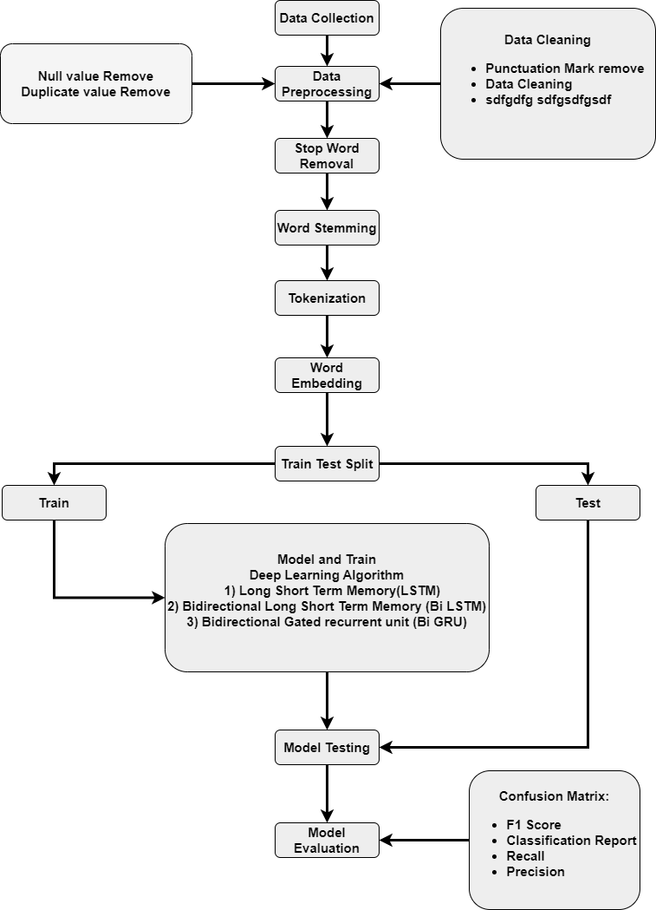
Flow Chart of Proposed System
09

Slide 13
Dataset
10
Collect data 1k and rest of them from online dataset
Class | Count
Politics | 1692
National | 1689
Amusement | 1673
Sports | 1630
International | 1628
IT | 1601

Slide 14
Result Analysis: LSTM
11
Training accuracy and validation accuarcy of model LSTM shown in figure:
Train accuracy | 95.86%
Validation accuracy | 76.29%
Precision | 73.23%
Recall | 73.98%
F1 score | 73.52%

Slide 15
Result Analysis: Bi-LSTM
12
Training accuracy and validation accuarcy of model Bi-LSTM shown in figure:
Validation
Train accuracy | 97.96%
Validation accuracy | 77.91%
Precision | 76.15%
Recall | 76.89%
F1 score | 76.66%
Validation

Slide 16
Result Analysis: Bi-GRU
13
Training accuracy and validation accuarcy of model Bi-GRU shown in figure:
Validation
Train accuracy | 97.28%
Validation accuracy | 76.10%
Precision | 75.09%
Recall | 75.91%
F1 score | 75.59%
Validation

Slide 17
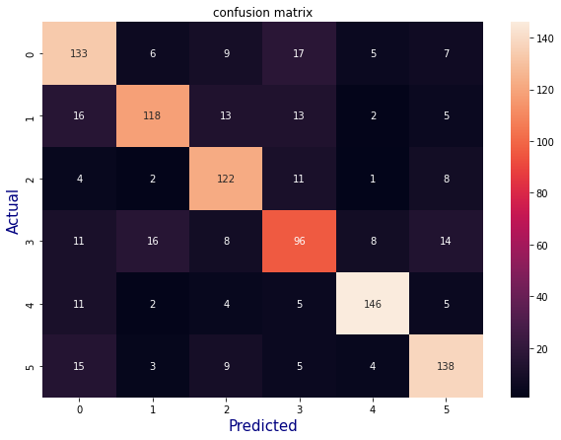
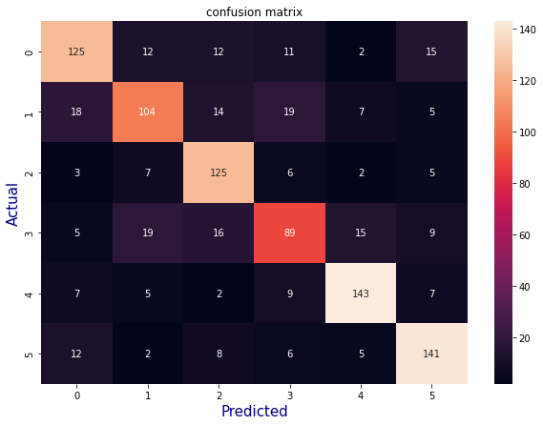
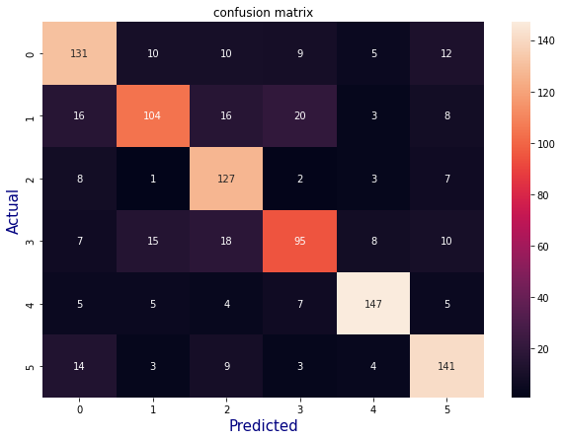
Result Analysis: Confusion matrix
14
Shown confusion matrix for LSTM, Bi-LSTm and Bi-GRU
Bi-LSTM
Bi-GRU
LSTM

Slide 18
Result Analysis
15
Result analysis of all the model
Algorithm | Train Accuracy | Test Accuracy
Long Short Term Memory | 98.85% | 73.28%
Bi- Long Short Term Memory | 98.95% | 75.90%
Bi -Gated Recurrent Unit | 99.28% | 75.10%

Slide 19
Conclusion
16
A very efficient system for Bengali News Headline classification is a challenging task. The Bengali language has numerous number of diversity and it is rich. The dataset is created in a way that covers most of the words that are relevant with the classes. The paper proposes Bengali news headline categorization with optimized Deep Learning

Slide 20
Limitations
17
My models are faced over fit due to data length, data preprocessing and tokenizer. Overfitting is a common issue when training deep learning models and it occurs when the model learns the training data too well and performs poorly on new, unseen data.
Overfitting can occur in deep learning models in LSTMs, Bi-LSTMs, and Bi-GRUs if the models are too complex or if the training data is insufficient.

Slide 21
Limitations
18
Lack of Feature
The data pattern is incorrect
Lack of Data
large amounts of irrelevant information
Model complexity is high

Slide 22
Future Work
19
In the future the work can be implemented to the inner method of the existing work. Some other algorithms such as the Greedy algorithm can be implemented to check if it performs well than the neural network.
Larger and Dierser Dataset
Transfer Learning
Fine – tuning Hyperparameters

Slide 23
Reference
20
[1] A. K. and S. Shrawne, “Location-Wise News Headlines Classification and Sentiment Analysis: A Deep Learning Approach,” pp. 389–397, 2019, doi: 10.1007/978-981-15-0633-8_27.
[2] S. S. Sharmin, M. A. Rahman, M. A. H. Khan, and M. S. Islam, “Bangla News Headline Classification using Deep Learning Techniques,” J. Phys. Conf. Ser., vol. 1529, no. 1, p. 012010, 2020, doi: 10.1088/1742-6596/1529/1/012010.
[3] G. Kaur and K. Bajaj, “News Classification using Neural Networks,” Commun. Appl. Electron., vol. 5, no. 1, pp. 42–45, 2016, doi: 10.5120/cae2016652224.

Slide 24
Reference
21
A. Hossain, N. Chaudhary, Z. Hasan Rifad, and B. M. M. Hossain, “Bangla News Headline Categorization,” Int. J. Educ. Manag. Eng., vol. 11, no. 6, pp. 39–48, 2021, doi: 10.5815/ijeme.2021.06.05.
[5] M. Rabib, S. Sarkar, and M. Rahman, “Different Machine Learning based 20 | Page Approaches of Baseline and Deep Learning Models for Bengali News Categorization,” Int. J. Comput. Appl., vol. 176, no. 18, pp. 10–16, 2020, doi: 10.5120/ijca2020920107.

Slide 25


